Slide 1
Morning Glory Detection
Jinge Wang

Slide 2
Motivation
For farmers, weeding has always been a big problem. With the higher degree of integration and larger scale of agriculture, manually spot the position of weeds would cost a lot of time and labor.
Detecting the weeds from the aerial images by the image processing method is a good attempt to improve efficiency and reduce cost.

Slide 3
Data
Images of a grape farm in California.
Photographed by UAV.
The weed in the grape bushes is morning glory.

Slide 4
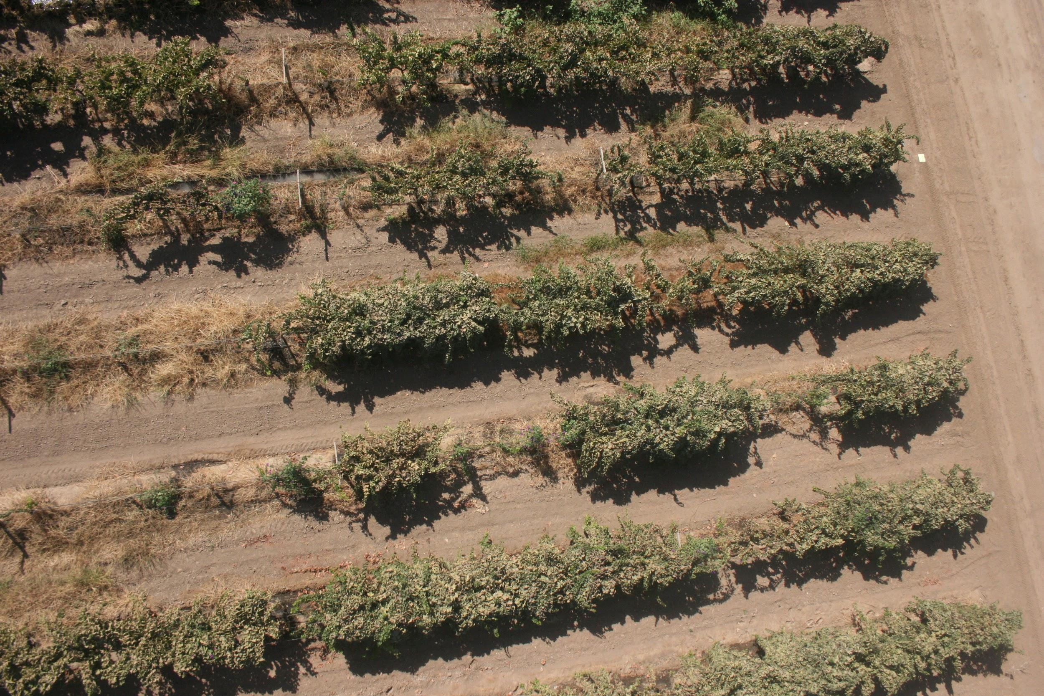
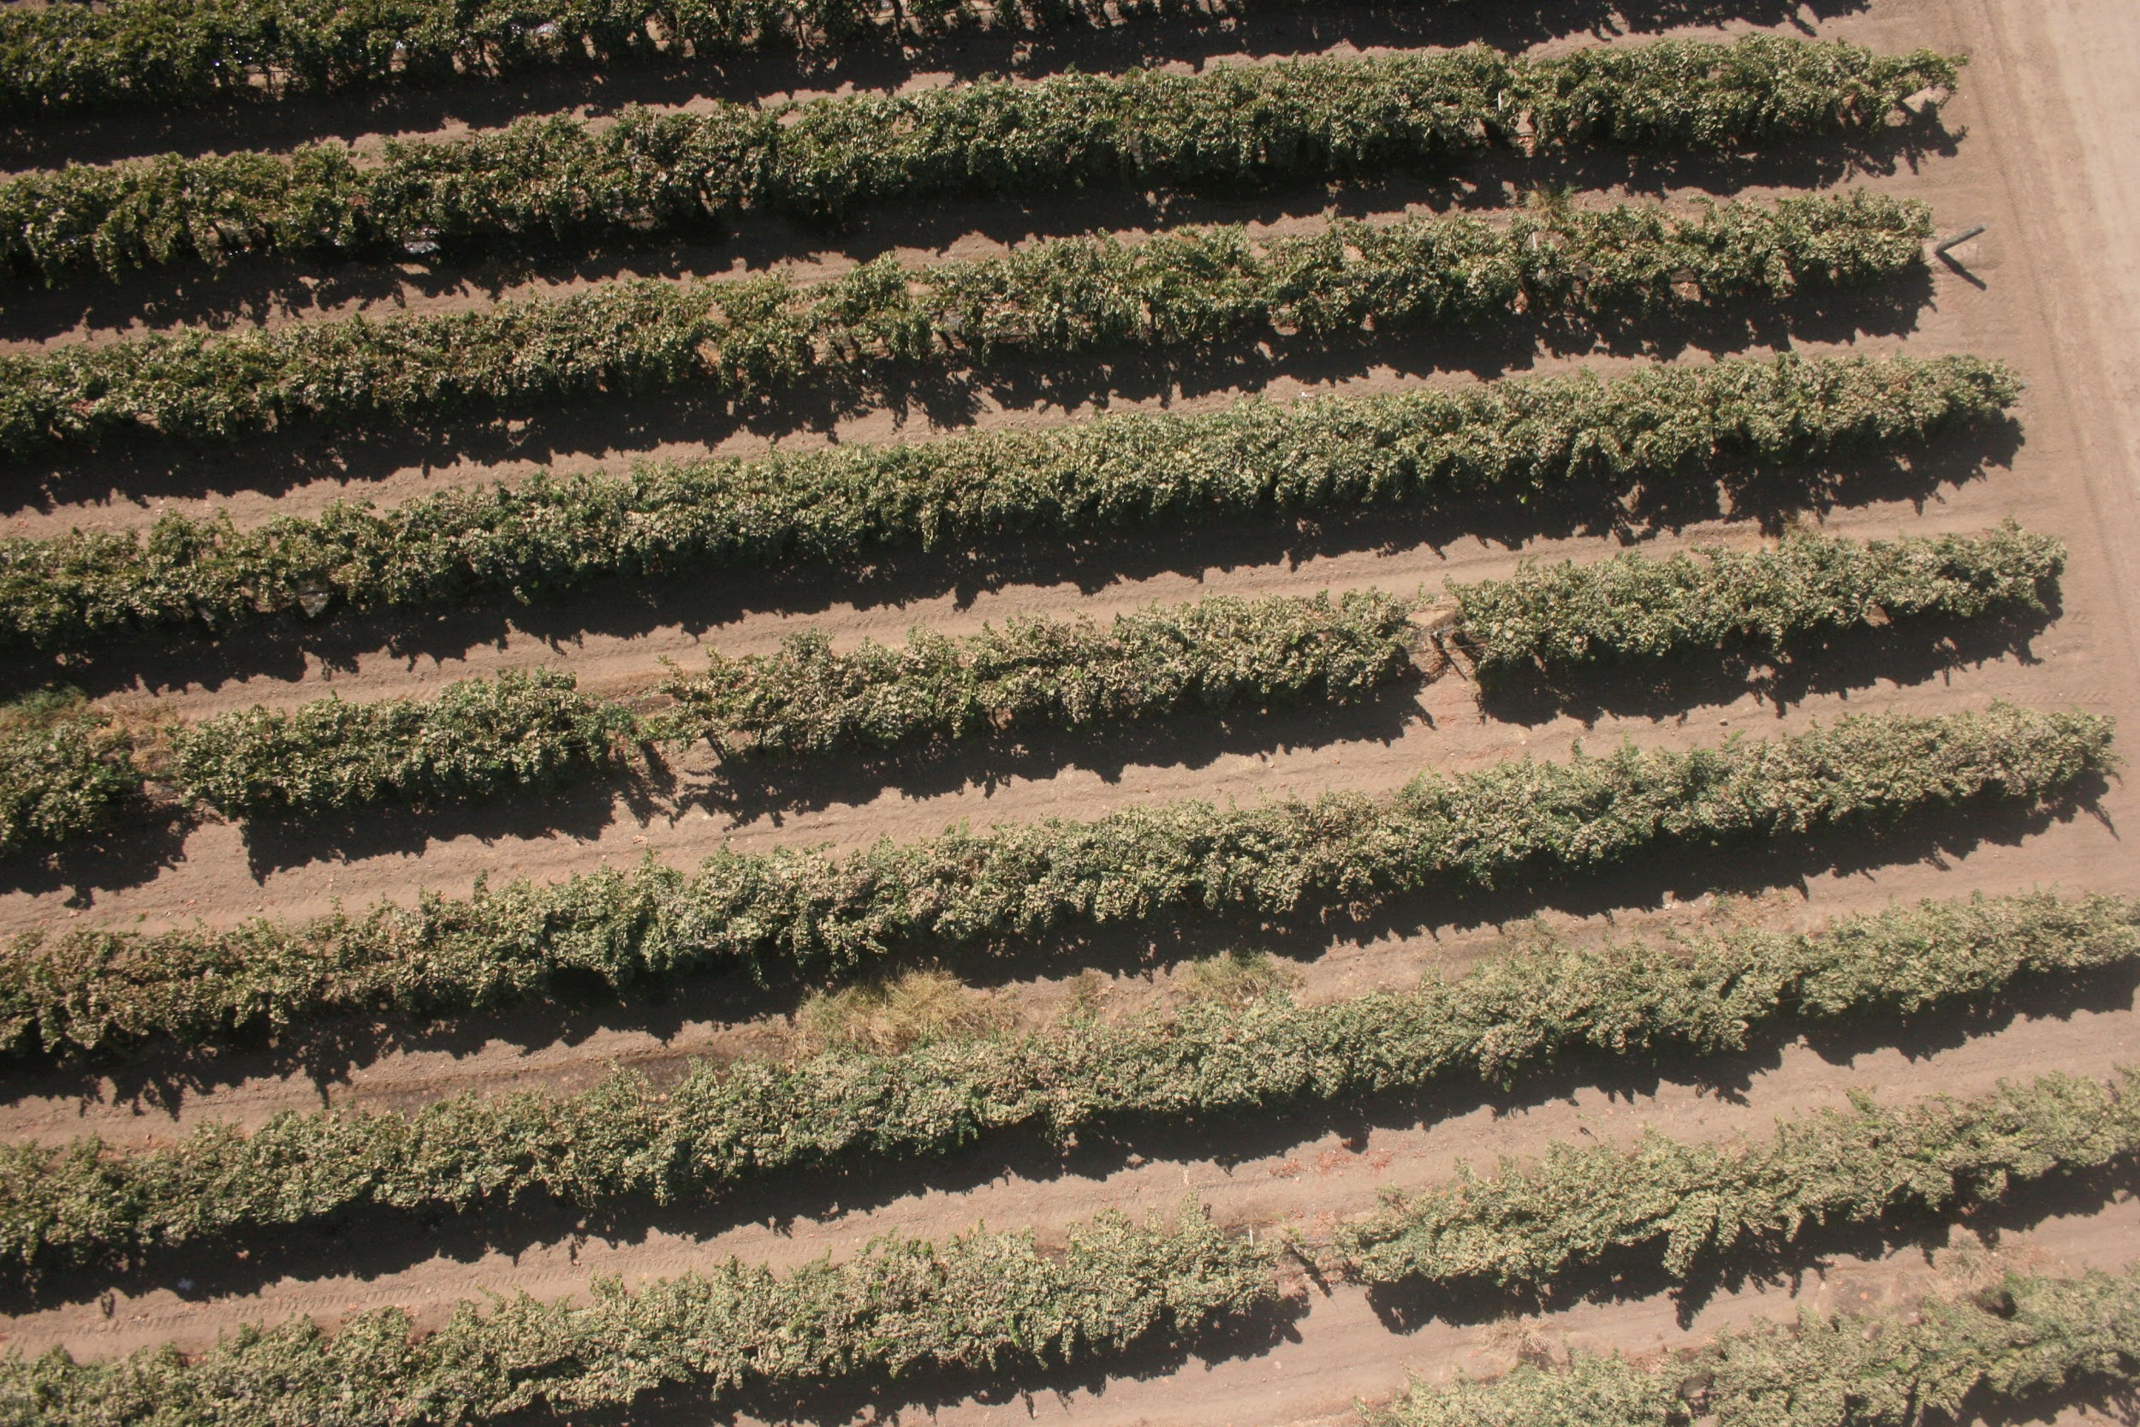
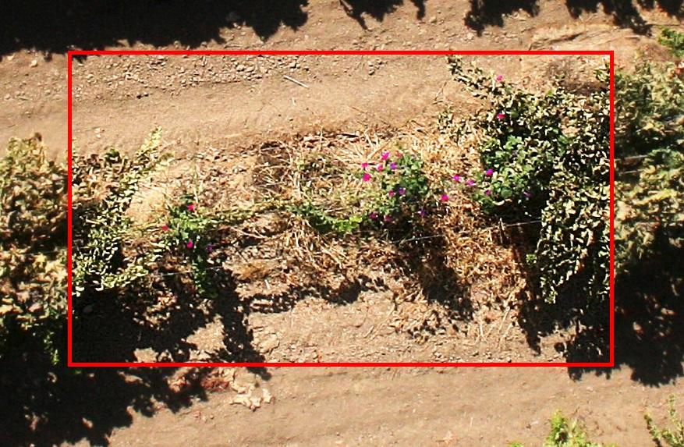
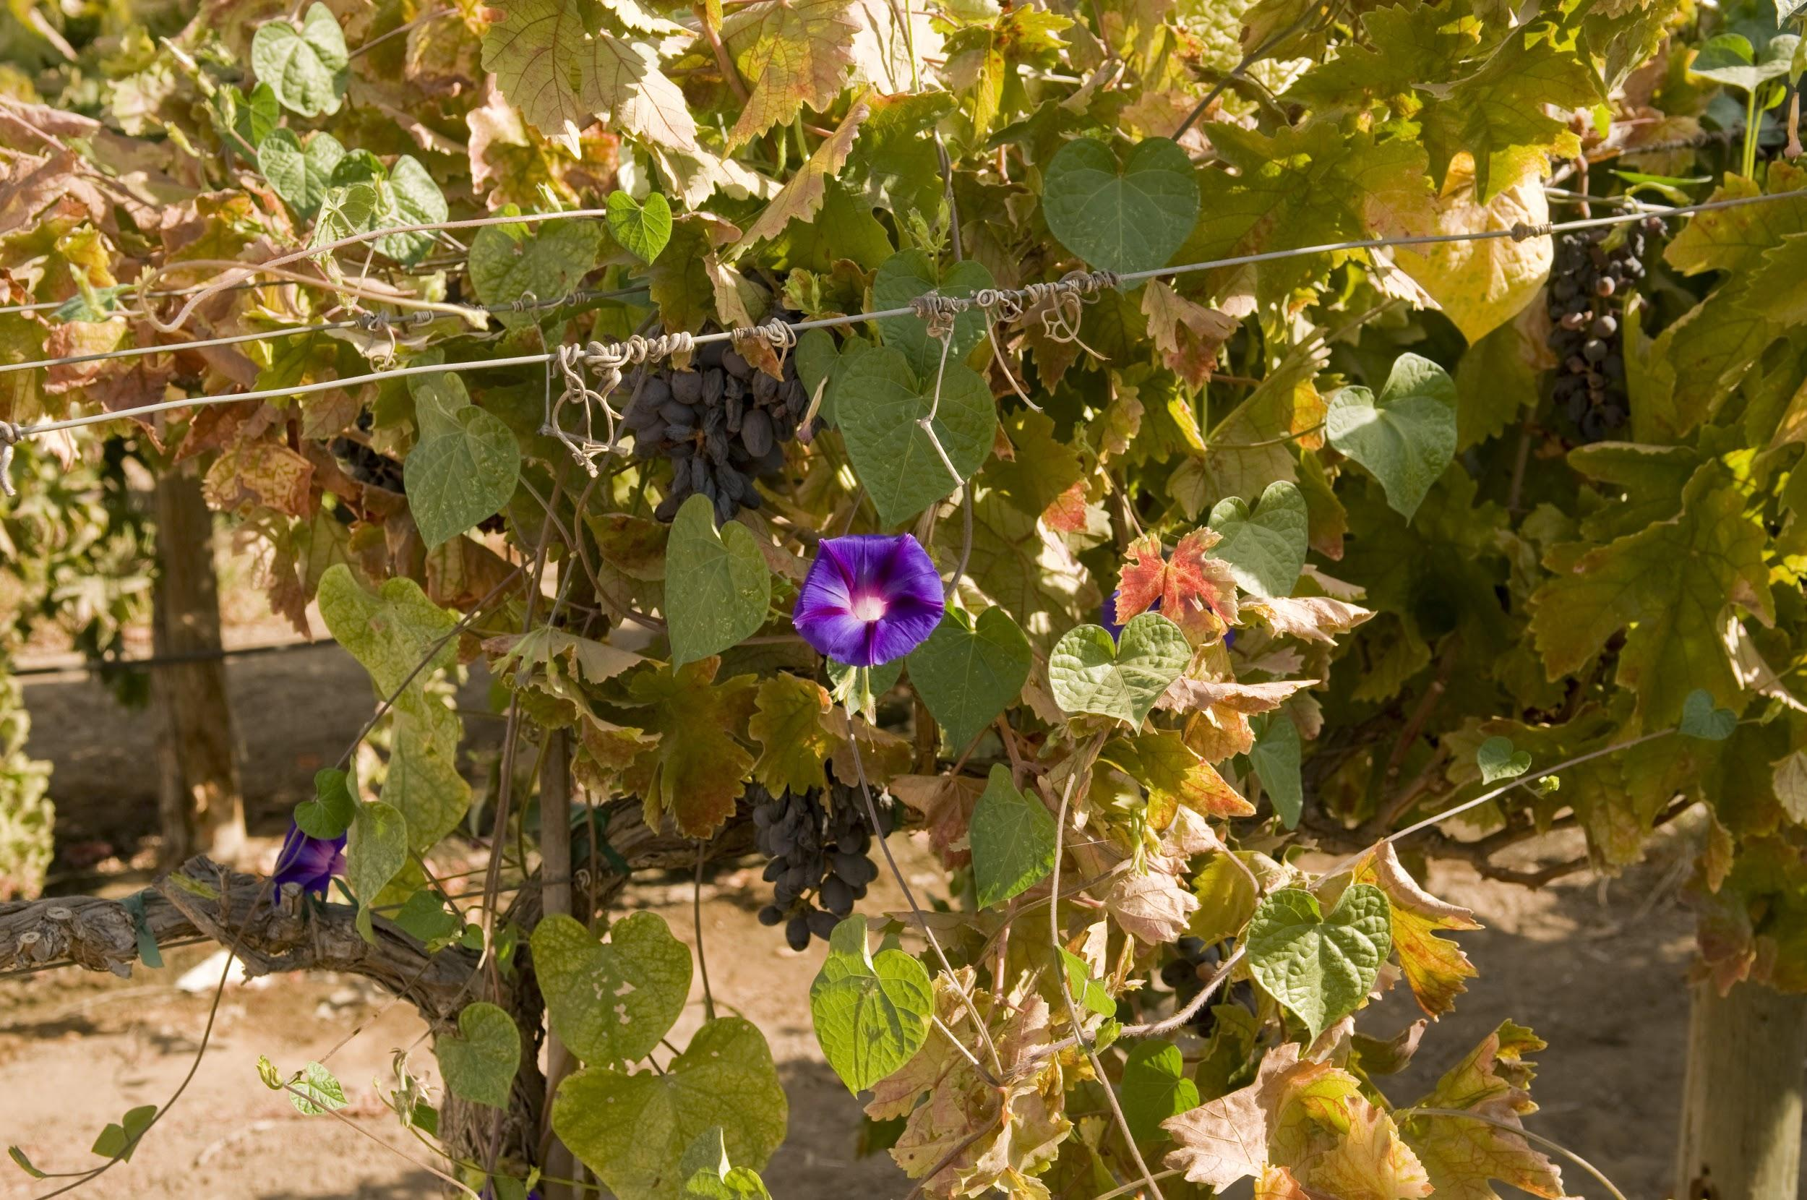
Data Sample

Slide 5
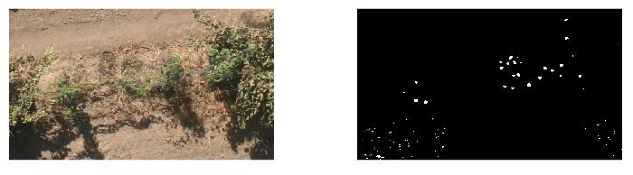
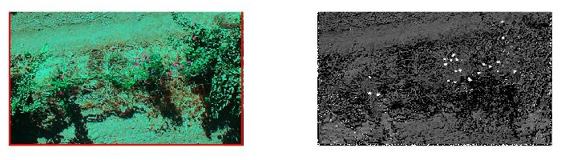
Attempt
Origin
Contrast Enhancement

Slide 6
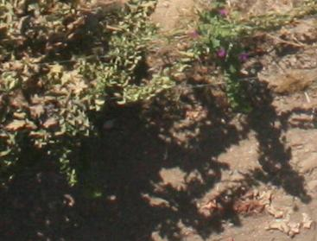
Noise
With a closer observation, we can figure out there are redish spots existing in the shadow.
To avoid this effect, we can do the shadow removing before morning glory detection.

Slide 7
Problems
The detecting target is tiny.
The features can be used to detect is limited.
The Image quality is low.
Noise.
Coverage(Not all the existing flowers can be taken into the photo).
Feature: Color
Noise: Shadow removal

Slide 8
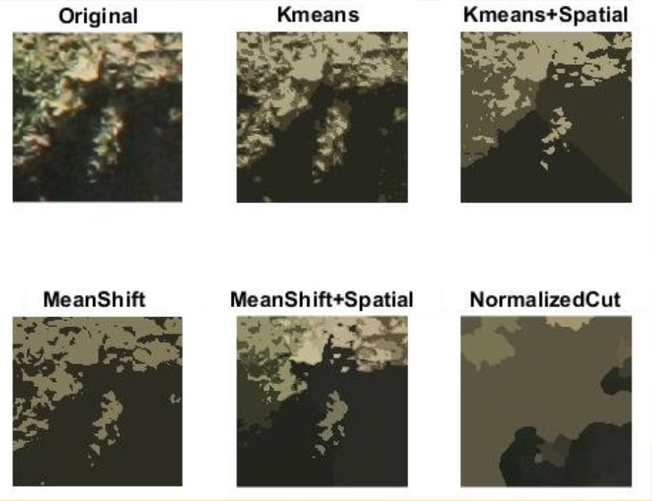
Experiment
Segmentation Method
The criteria for making decision here is not only separate the shadow but preserve the information in bushes as much as possible.
Among the segmentation result of this specific patch, Kmeans and Kmeans+Spatial are visually better than others.
* MeanShift looks good if we consider this image only have two clusters. I tested the result,which is similar to that of Kmeans when K= 3.

Slide 9
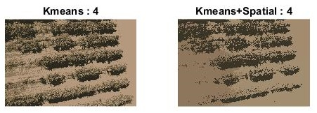
Segmentation
But for the whole image, Kmeans has more reasonable performance

Slide 10
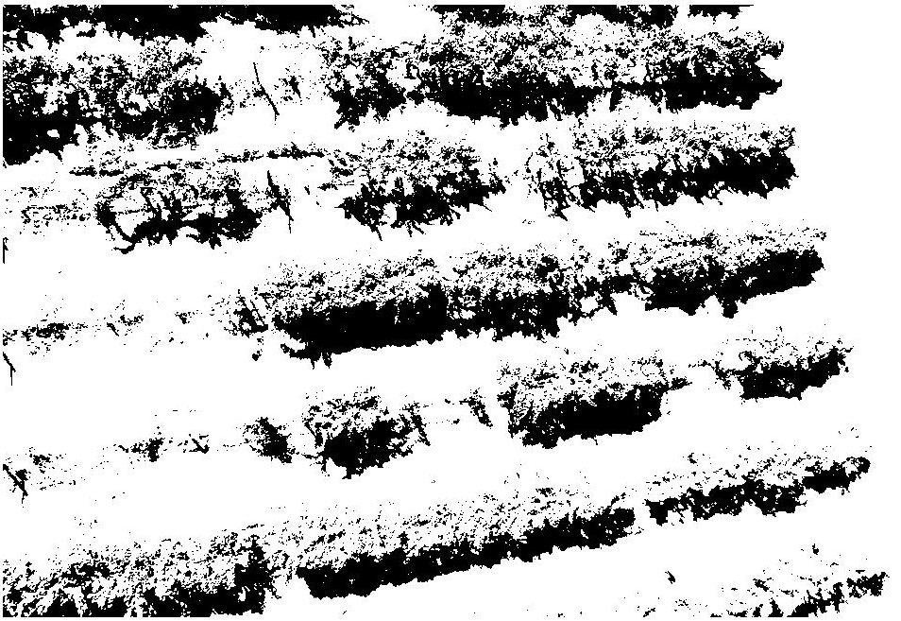
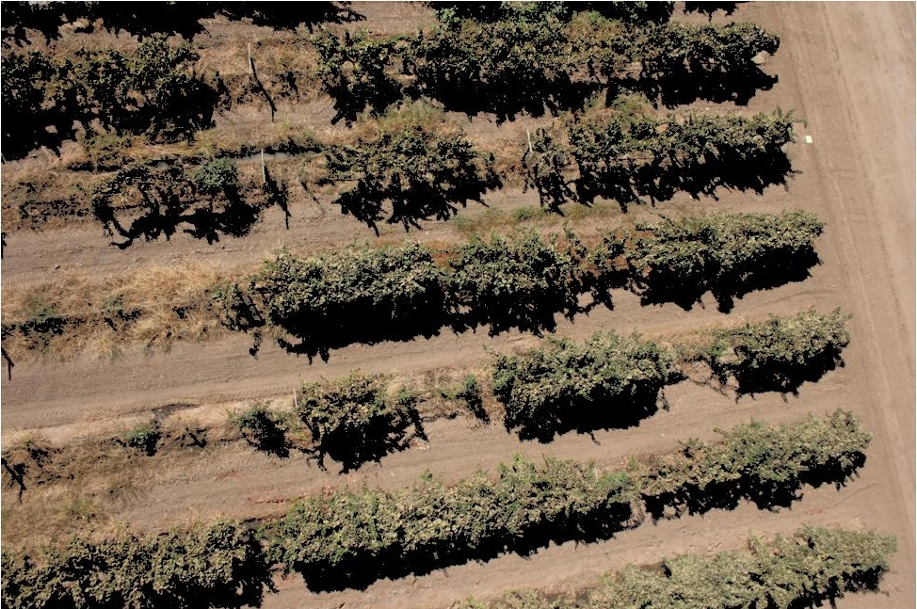
mask
After segmentation by Kmeans, I generate the binary mask of the image (Left). Shadow region is 0, the rest are 1s.
Then I use the original image piont multiply the mask to get the shadow removal image (Right).
What is Associative Classification?

Slide 11
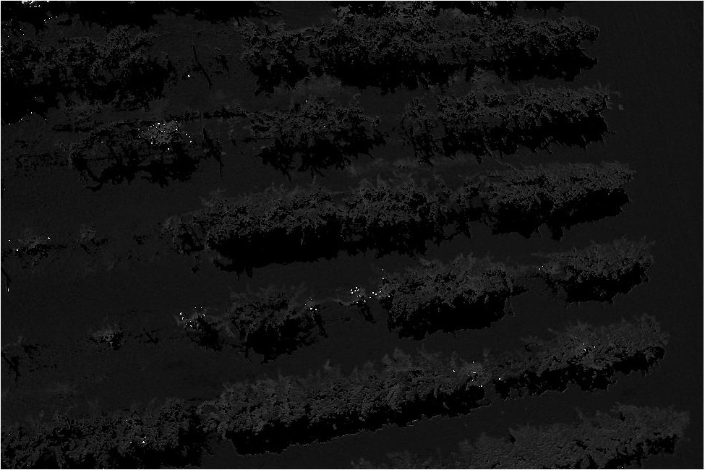
Detection
I transfer the shadow removal image to the HSV color space.
The display on the left is the Hue space.
Purple- wise color, the color of the morning glory, has significant representation in the Hue space.(https://en.wikipedia.org/wiki/HSL_and_HSV)

Slide 12
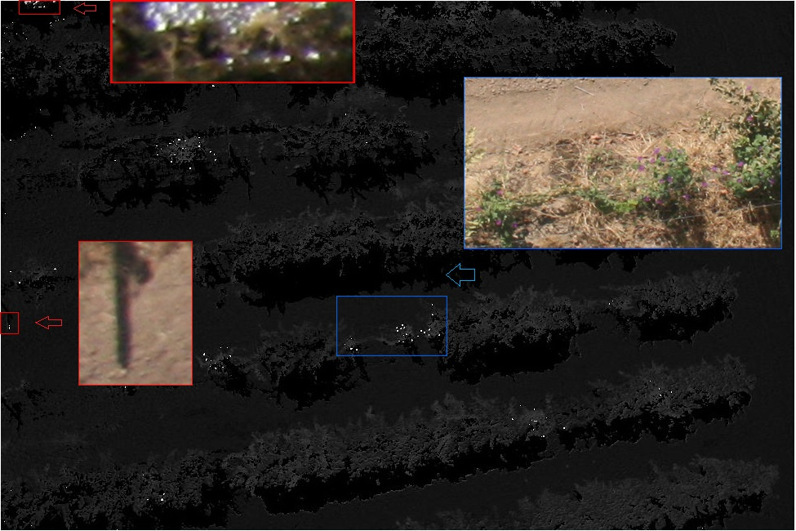
The red rectangles reveal the false detection.
The blue one is the ideal result.

Slide 13
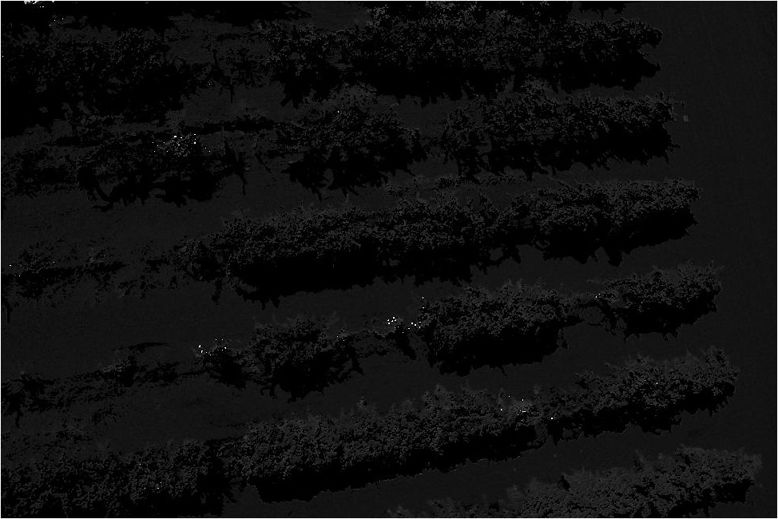
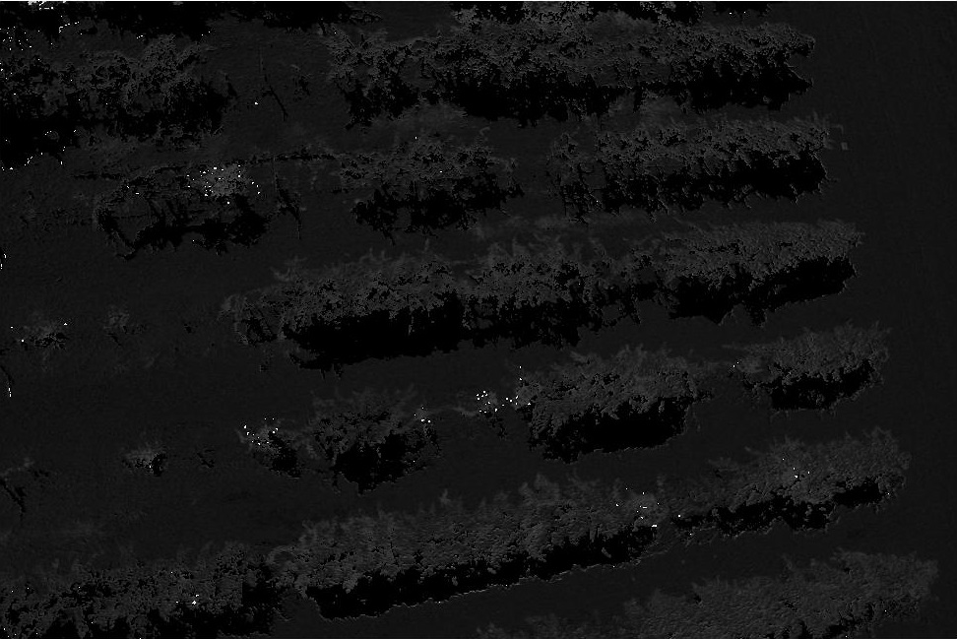
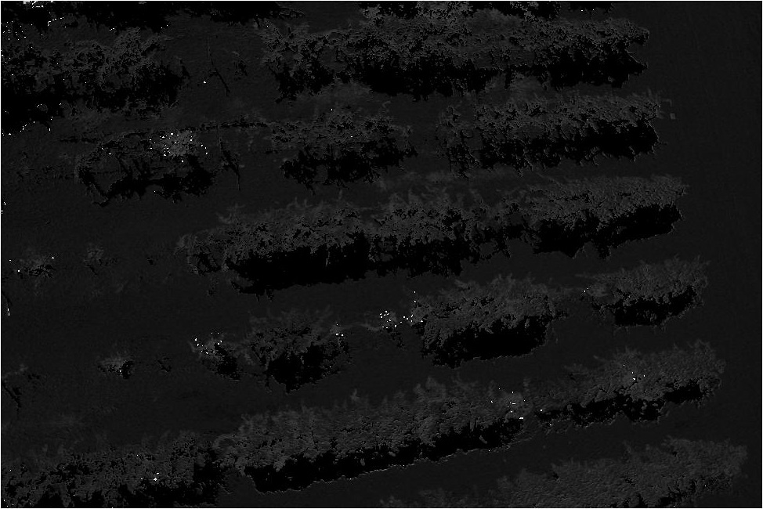
Comparison
k=2
k=4
k=6
k=10

Slide 14
Conclusion
The shadow removing is benefit in the morning glory detection job.
HSV transform may not be helpful in other situation.
The decision of K is a trade-off between reducing false detection and improving detection coverage.
This method would performance better with higher quality data.

